Slide 1
How Neural Networks Learn
Student: Khoren Petrosyan
Supervisor: Arsen Mamikonyan

Slide 2
Thesis motivation
Neural Network are very powerful tools in Machine Learning, but not much is understood about the way they work
A lot of mistrust is present because NNs are viewed as black-box methods
The public questions if these methods can be used for purposes as serious as autonomous cars, deciding jail sentence, or loan credibility
Hard to explain and even know why and when NN can learn
As a result a lot of unexplained phenomenon (On the importance of single directions for generalization - Ari S. Morcos et. al)
Hard to have informed intuition of how and what will work on NNs (like new activation functions)

Slide 3
Choice of the type of the Neural Network
I choose to examine Feed Forward Neural Networks in this thesis, because ideas and principles of these networks are at the core of all other types networks with some modifications.

Slide 4
Thesis structure:
Four experiments
Each experiment has three sections
What question the experiment tries to answer
The description of the experiment itself
Explanation of the results
Implications
Conclusions

Slide 5
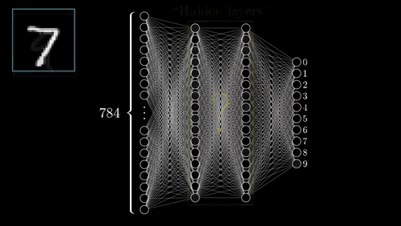
First let’s get some background first

Slide 6
Feed Forward Neural Networks
Feed Forward Neural Networks consist of layerwise dot product of weights with the output of the last layer and a non linear activation (ReLU, tanh).
In case of the first layer, the weights are multiplied by the input itself.
Last layers output is the prediction which gets then corrected by the true output provided as a ground truth.
Then weights get tweaked to better match the input/output pattern
Step 4 is done by an algorithm called Backpropagation Algorithm

Slide 7
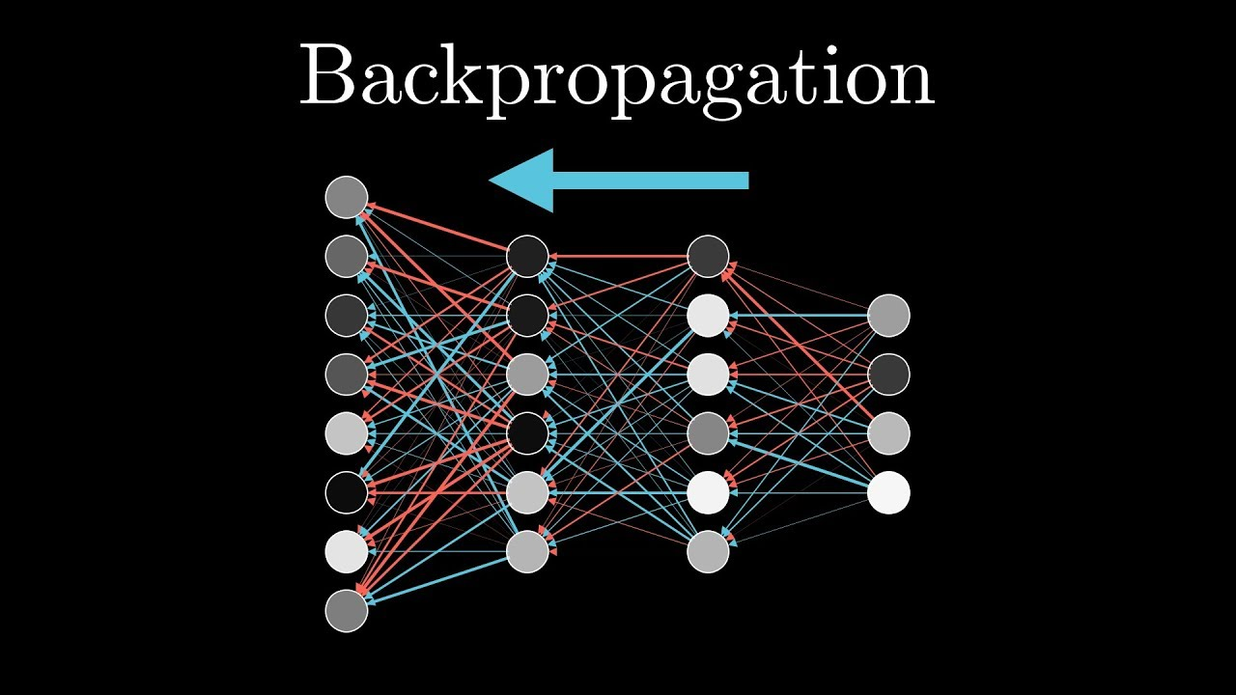
How Backprop works

Slide 8
Theory behind Backpropagation algorithm
After the input executes a forward pass, the difference between the prediction and the ground truth is calculated
It’s done by a loss function which measures the discrepancy between the prediction and the ground truth (usually MSE or Cross Entropy Loss function)
Then the partial derivative of weights with respect to the loss function is calculated - the gradient of weights with respect to the loss function
Gradient is the direction of the steepest ascent, so -1*gradient is the direction of the fastest ascent of the loss function
Weights get changed in the direction of the steepest descent of the loss function (-1 * gradient)

Slide 9
Partial derivatives are uninterpertible and unintuitive
Everything works just fine (usually), but seems like magic, because it’s hard to understand, at least on the level of intuition, what and how are these networks learning.

Slide 10
Experiment 1.
Motivation:
In this experiment on the example of Feed-Forward Neural Networks on classification task I’ll try to demonstrate how much information a single neuron carries, and how neurons on the next layer “use” that information.
What a particular value of the activation function of a neuron “means”
After all neurons exchange information to be able to make predictions, but how exactly?

Slide 11
Description:
In this experiment I visualize the activations of neurons during training.
Two datasets are used, MNIST handwritten digits dataset and a fake one
Fake dataset is a (100,100) matrix of random numbers drawn from uniform distribution
Fake dataset is used as a control test to be sure that findings are not specific to MNIST only.
During experiment, activation values of intermediate layers of NN are extracted and plotted as points with values generated by inputs of the same class drawn in the same color.

Slide 12
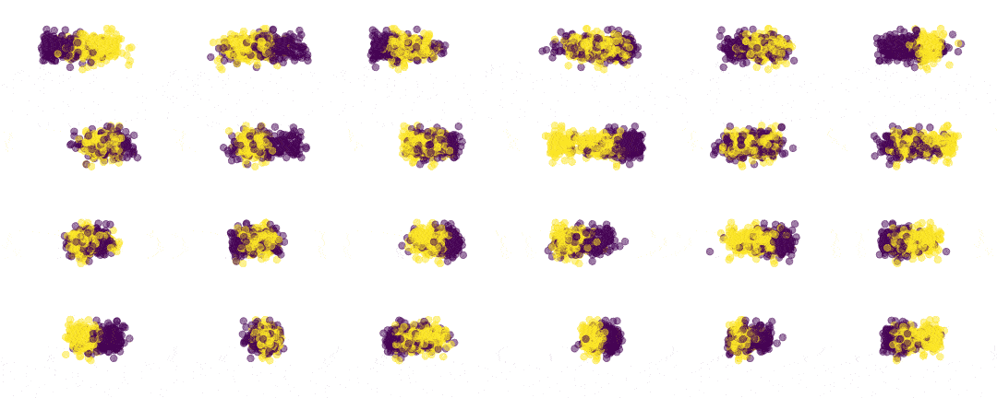
Activation visualization
X axis is the value of the activation of the neuron, when 500 examples are passed through the network
Y axis is auxiliary and used only for better visualization

Slide 13
As we can see, at first activations are random and overlapping for both classes, as this activations are only influenced by the initial weight initializations. But over time they start to split. In this example I’m using a tanh activation function (easier to visualise and explain) so the neural network starts to separate the activation values of two classes, with one class approaching to -1 and another one to 1.
Note that activations of the same class don’t necessarily approach the same side (first two neurons on the first layer).
Note also that neuron on layers closer to the input separate activations less than the ones closer to the output layer. This is due to the vanishing gradient.

Slide 14
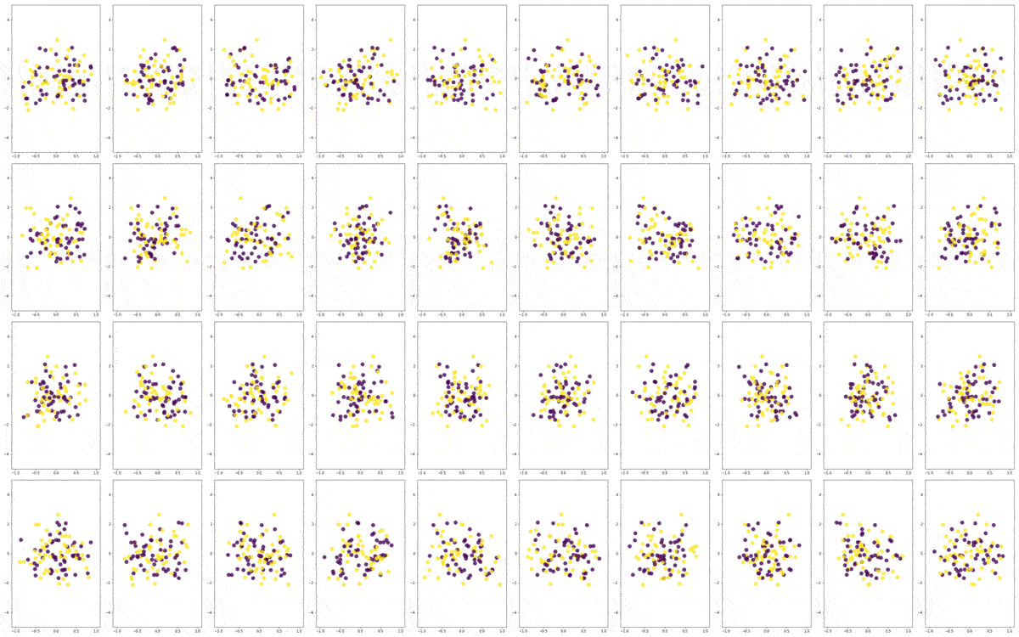
With random data the same effect is present

Slide 15
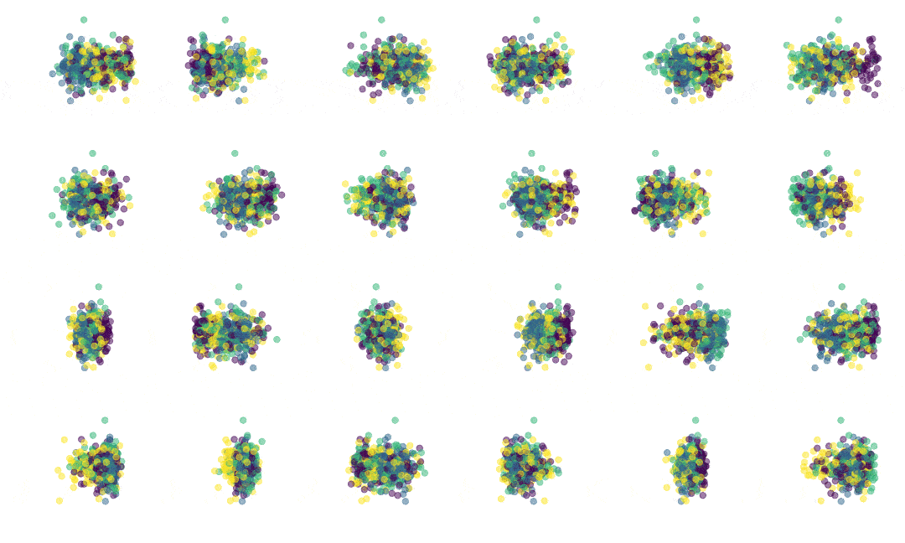
What will happen with more than 2 classes?
The same, but now groups of classes are separated

Slide 16
Summary
From the activation visualizations we can see, that during training Neural Networks try to separate class dependent activations. With more then two classes this mean that a subgroup of classes are “thrown” on one side of the activation and the rest on the other.
Very Important implications:
This means that activation values of neurons can have meaningful interpretation : activation value, depending on what side of it falls, can indicate that the input belong to one of the classes that activate on that side. This information is later picked up by the next layer.
Over layers, the variation decreases, which is natural, given that we want the class conditional variation to be 0 at last layer.
The more the number of layer, the more gradual the decrease in variance and flexibility
Neurons are all doing the same thing. They try to split class conditional activation.

Slide 17
Experiment 2:
Motivation: as I indicated on the previously, neurons try to split class conditional activations, hence the next layer of neurons maybe remembers it to help itself split the activations even further (but not necessarily the same way).
This means that for a neural network, a class is just a specific activation pattern : a pattern of -1s and 1s in our example with tanh.

Slide 18
Description:
Let’s prove this by extracting the activation pattern of a certain class and then gradually changing it. If we have 2 classes, and if our intuition that a class is an activation pattern of -1s and 1 is correct, then we can extract the pattern of activation of one class and flip its sign neuron by neuron and network must change it prediction over time.

Slide 19
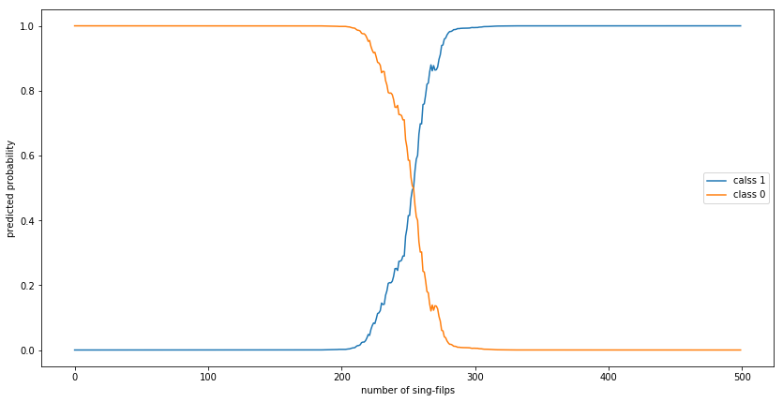
Pattern flipping

Slide 20
Explanation:
As we can see, network predicts the class to be zero with very high probability until around 200 out of 500 neuron activations are flipped, then it decreases reaching 0.5 probability (uncertainty level) when around half the activations are flipped.
As the plot suggests, the decision boundary for belonging to one class or the other is at about 500/2 filed signes. So as we change the signs in from the "ideal" case for one class, neural network gradually starts to increase the probability of the other class.

Slide 21
Experiment 3:
Motivation: A lot became clear about neural networks from previous paragraphs, but saying that neural networks using Backpropagation algorithm optimize their weights by converging to the local vector that splits class activation is not an intuitive explanation. In this and next experiment I try to give more and better visual clues to understand how exactly everything happens in a more intuitive manner.

Slide 22
Neural Network is just a multilayer, interconnected logistic regression
It has long been known that when one applies logistic regression (which is in fact a one layer Feed Forward Neural Network - without hidden layer) to MNIST and then visualize weights corresponding to each class, the plots look roughly like a template visually very similar to the pictures in that class.

Slide 23
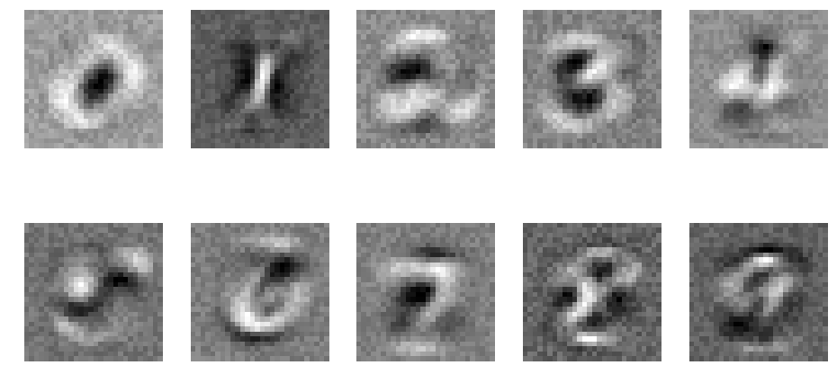
Visualization of weights logistic regression learned on MNIST

Slide 24
Question arises
One can clearly (or less so) see contours of digits, as if logistic regression learned a template for each class. But this change when we do the same with neural networks.
Let’s do the same visualization for a neural network.

Slide 25
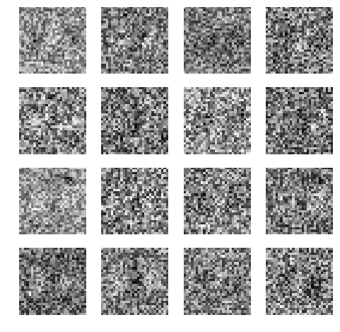
Visualisation of the weights of the first hidden layer

Slide 26
Maybe NNs do something smarter then?
Because of that many believed that Neural Networks are doing something smarter maybe. Maybe they learn global features like edges and loops instead of just constructing a template of the class.
This is not true tough, Neural Networks create class templates themselves too, but the create a joint template.

Slide 27
Experiment 3:
Motivation: explain why NNs don’t do (they actually do) template matching.
Description: let’s do the same, but now divide the inputs by a big number like 100000, and make the same visualization again. I’ll explain the dividing later.

Slide 28
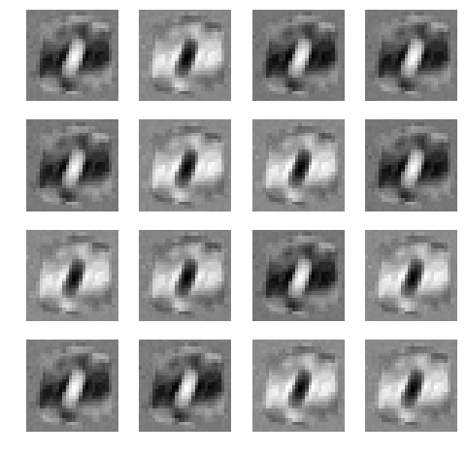
Results after dividing input by a big number

Slide 29
Explanation:
Division changed everything. It turns out the changes in weights were very subtle, and we had to divide the input by a large number to force the weights to grow bigger for us to notice.
As you can see it just created a "joint template" for both classes. This looks very similar to the scatter plot of pixel values above. It's easy to notice that weight matrices differ by sign and (7 with one sign and 9 with another, roughly equal number).

Slide 30
Explanation continued:
What happened is that the network learned which pixels are most likely to belong to which class, and created a joint template for those, but as we’ve seen from Experiment 1 network tries to separate class conditional activations, so in a given template, if the regions that belong to 0s are drawn with black (have negative values), then the regions belonging to 1s will always have the opposite color.

Slide 31
Experiment 4.
Motivation : how does the network create this template?
Description: Experiment is fairly simple, it tries to show what is the network learning on each iteration by visualizing the gradient vector.

Slide 32
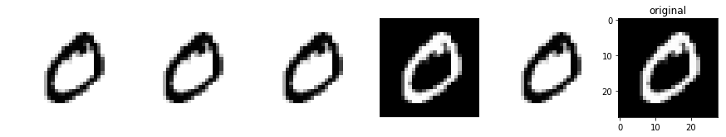
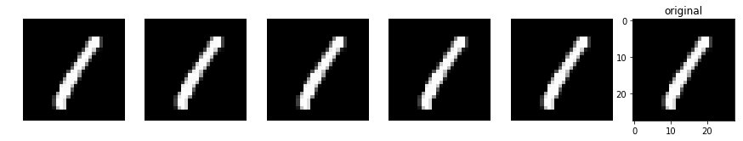
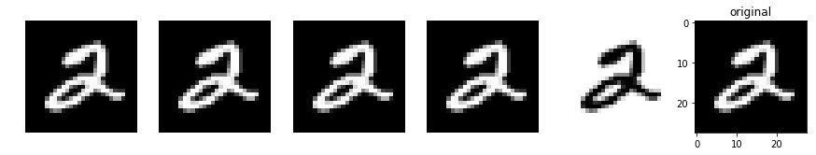
Visualization of the gradient vector over single inputs

Slide 33
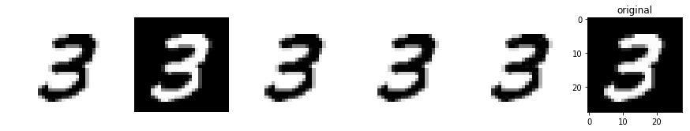
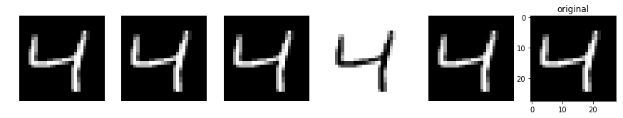
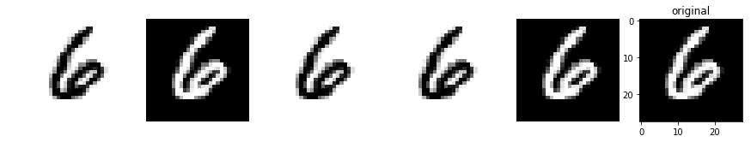
Visualization of the gradient vector over single inputs

Slide 34
Explanation
These visualizations are not tampletes anymore, these are concrete images form the data set, and as we can see, the gradient replicates the image perfectly.
This means on every iteration the network changes its weights a little bit to match the input it was given. This explains the joint template phenomenon.
This provides the effect discussed in experiments 1 and 3, that network learns how to split class conditional activations. Also this explains how we get the templates in experiment 3

Slide 35
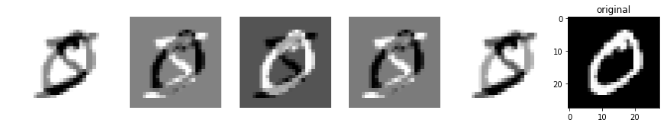
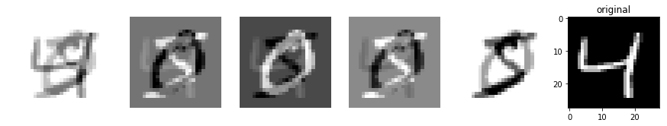
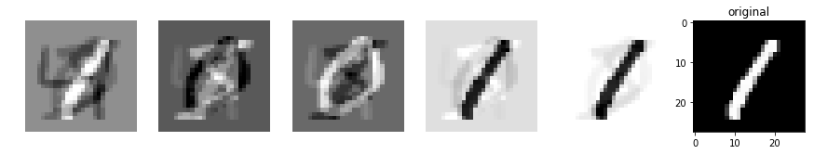
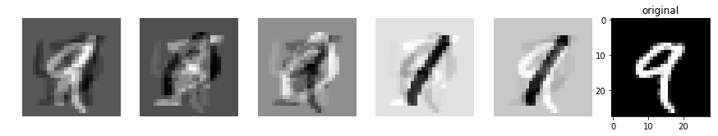
Momentum
Interesting to notice, that you can observe the effect of adding a momentum term. Then a single image persists for several iterations and slowly fades away.

Slide 36
What about the intermediate hidden layers?
Question arises, does this phenomenon typical only to the first layer or all the layers?
Answer is, as far as neural network is concerned, it doesn’t differentiate between first and hidden layer, and for the network, the input values are like the activation value of its previous layer.
This is important because this highlights the importance of normalizing the inputs, so it falls roughly at the range of the activation values of the activation function of the network.

Slide 37
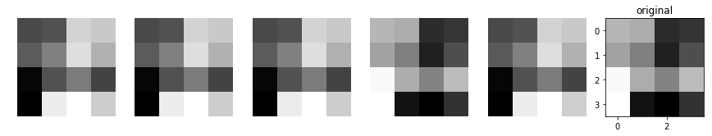
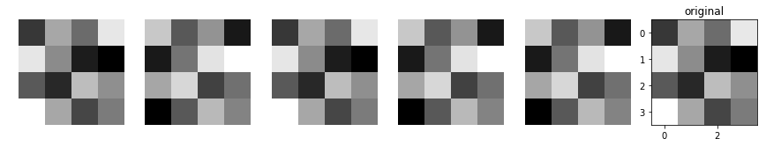
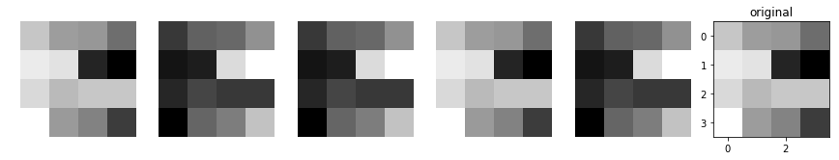
Gradient of the hidden layers
First 5 are the gradients of 5 neurons, the last one is the activation vector. These 3 plots were constructed using for 3 different inputs.

Slide 38
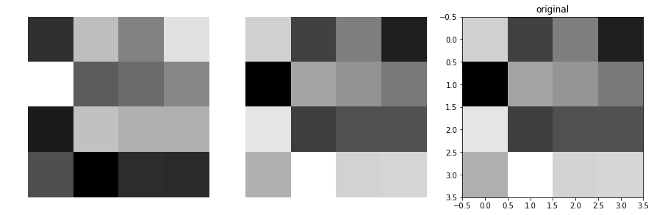
Let’s have a closer look

Slide 39
As you can see, as with the example of the input images, the gradient repeats the pattern. This is as I said earlier, because as far as the network is concerned, our input is just like the activation values of its previous layer. So here the role of the input image plays the activation vector of the previous layer.
We can make an important generalization : each layer of the neural network, including the first one, changes its weights in the direction of or in the opposite direction of its activation vector, depending on the class of the input but consistent for a fixed class.

Slide 40
Results:
This thesis showed that Feed Forward Neural Networks, unlike Convolutional Neural Networks, do NOT learn general features like edges and loops, but instead create joint templates of its inputs. Thesis also provided new approaches to visualizing understanding Neural Network, that could potentially lead to some interesting research. One important generalization was made : each layer of the neural network, including the first one, changes its weights in the direction of or in the opposite direction of its activation vector, depending on the class of the input but consistent for a fixed class. This means that neurons on all layers do the same thing, and don’t specialise in any clever way.

